Slide 1
03 | Web API Configuration
Jeremy Likness | Principal Architect
Christopher Harrison | Content Developer

Slide 2
Module Overview
Media Formatters
Camel Case and Serializers
Routes and Actions
Attribute Routing
Custom Content Negotiation

Slide 3
Media Formatters
What’s your vector, Victor?

Slide 4
Media Formatters
Media type = MIME type
Examples: text/html, application/xml, application/json
Accept (what it wants), Content-Type (what it gets)
Built in formatters: XML, JSON, BSON, form-encoded
Create custom with MediaTypeFormatter, BufferedMediaTypeFormatter

Slide 5
Custom Media Formatter: CSV Export
Notes:
03aCustomMediaFormatters

Slide 6
Camel Case and Serializers
Configuring the existing formatters

Slide 7
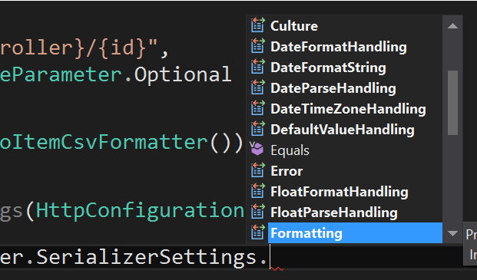
Camel Case and Serializers
MediaFormatter performs serialization
Several SerializerSettings

Slide 8
Proper JavaScript Case
Notes:
03aCustomMediaFormatter

Slide 9
Routes and Actions
The perfect marriage between a URI and your code

Slide 10
Routes and Actions
Route template
Api/{controller}/public/{resource}/{id}
controller = controller name
action = action (usually omitted)
Provide default values
defaults: new { resource = “widgets” }
Constrain
constraints: new { id = @”\d+” }
Optional
RouteParameter.Optional

Slide 11
Routes and Actions
Select Controller
Route Dictionary
{controller}+ Controller
{controller} [type]
Select Action
HTTP Method
{action}
(params)
Controller .Method()

Slide 12
Attribute Routing
It’s the new style to get what you want
Notes:
03bRoutingActions

Slide 13
Attribute Routing
Child resources
Add the attribute to the controller action
Must enable in configuration:
config.MapHttpAttributeRoutes();
Use RoutePrefix for a common prefix on the controller
tilde to override (i.e. “~/api/overrideprefix”)
May include parameters
Pass constraints (int, alpha, bool, etc.)

Slide 14
Routing and Actions
Notes:
03bRoutingActions

Slide 15
Custom Content Negotiation
When what’s there isn’t enough

Slide 16
Custom Content Negotiation
MediaTypeMappings
QueryStringMapping
UriPathExtensionMapping
RequestHeaderMapping
Own Formatter
Derive from default, override MapRequestMediaType
Implement IContentNegotiator

Slide 17
Custom Content Negotiation
Notes:
03cCustomContentNegotiation

